Slide 1
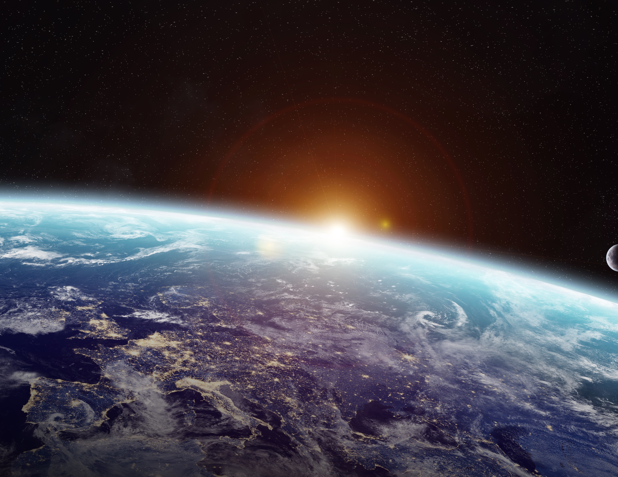


Richelle Buchner
Governmental Partner
Join the good move
Erik Lenssen
E-mobility Product en Charging manager

Slide 2






Wie zitten er in de zaal?
Check-in
Ontdekker
Aankoper
Orienterend
Verplichte…
Notes:
Purpose :
Round-table for self-presentation in the context of this subject
Opportunity for participants to express their mindset
Facilitation-----showing slide is optional
1- Introduce yourself as Planet Champion, also add :
Not expert of the subject
Volunteering because of personal motivation
2- Launch the roundtable, self-presentation plus ice-breaking question
! - Circulate attendance list
----- Find more in Course Guide ---------------------------------
attitude toward the session of today: as an Explorer, Shopper, Vacationer or Prisoner.
* Explorers – Are eager to discover new ideas and insights. They want to learn everything they can about the subject.
* Shoppers – Will look over all the available information and be happy to go home with one useful new idea
* Vacationers – Aren’t interested in the session, but are happy to be away from the daily grind.
* Prisoners – Feel they have been forced to attend and would rather be doing something else.

Slide 3


Waar staan we vandaag de dag en wat is ’the good move’?
?
Een reis
?
Vandaag
?
Klimaatverandering en onze rol in de strategie en ambitie
?
?
Notes:
Purpose : Put the subject in today focus + Give perspective on future steps
Script:
We are at the beginning of this journey. We hope you will continue after today!
Facilitation
Today focus is Commonground: climate change and our responsibility in decarbonization
Maybe frustrating because the subject is so wide and this seems a specific focus only
But you can continue the discussion after the session
Plus, the Planet Champions will propose other subjects later

Slide 4

We maken allen deel van uit
Onze
toekomst
Kennis en ervaringen delen
Notes:
Purpose : Set rules for the session
Facilitation
The title of the slide is “our future”. It recalls what is at stake : the future. It the big reason why we are gathered today: because we are all part of the future. In the company we need to share the same knowledge in order to have a common language. Therefore, we need to have good discussions.
For good discussion, we need to listen and respect each other considering that all questions, feelings, reflections, ideas.. are worth listening.
Do you agree?
(The role of the facilitator is to get agreement of the group on these principles).
These rules belong to the group, anybody who feels we are deviating can react.
Do you need something else?
(it can be some practicalities, like switch off phones, close doors,….)
Transition
We are all set, ready to start.

Slide 5






Join the good move
Notes:
Purpose : Introduction
Script:
<click>
Again welcome to this Planet Camp about Decarbonization!
Today you will learn why Renault has committed to be carbon neutral by 2050, how we can achieve it and what that means to you.
What can you do, to help us reach our goals?
What must we all do?
Facilitation : Recommended : prepare the agenda before session, and show it at this moment, as you speak.
Part 1 What is the problem
Part 2 Our commitments as a company
Part 3 Our strategy and transport solutions
Transition: But let’s not start there.

Slide 6

Het probleem
Het commitment
De oplossing
Notes:
Purpose : Announce three parts and what you will cover today
Slide is optional. Other option is to write the agenda on the board, so that participants can better follow the progress into the session.

Slide 7
Deel 1
Wat is het probleem?
Notes:
Purpose : yes there is a problem
Script
To understand what is the problem, let look at the Green house effect.
What do you know about the greenhouse effect?

Slide 8




Het broeikas effect
Notes:
Purpose : natural Greenhouse effect keeps the planet friendly but human activities are disturbing
--------
Script
The greenhouse effect as such is not a problem. It’s a natural effect that regulates the earth’s ground temperature. Some of the infrared radiation from the sun is trapped by gases in the air and this keeps the earth warm enough to sustain life.
The number one greenhouse gas is water vapor.
Click
Lately however, the levels of C02, and other greenhouse gases, have risen and caused an enhanced greenhouse effect. And that is a problem.
--------facilitation ------------------
This slide is key. Secure full understanding.
What is a greenhouse ?
This is the same with the atmosphere around the globe.
Rays that come from the sun, part is kept in the atmosphere, part is returned.
The greenhouse effect is beneficial as long as it is in its natural state.
Human activity disrupts this phenomenon, generating greenhouse gases.
That is, gases that keep heat in the atmosphere.

Slide 9
6X
Meer straling
Wat is de impact?
Notes:
Purpose of this facilitation :
This interaction verifies that people are following. Let them understand what it means
Radiative forcing
Multiplication by 6: unprecedented, very first time
If they don't know: no big deal, we repeat. Go back to former slides.
Participants will raise their level of attention.
----------- More in course guide ----------------
A concept called "radiative forcing." This is a measure of the influence that an independent factor (ice albedo, aerosols, land use, carbon dioxide) has in altering the balance of incoming and outgoing energy in the Earth-atmosphere system. It is also used as an index of the influence a factor has as a potential climate change mechanism. Radiative forcings can be positive or negative. A positive forcing (corresponding to more incoming energy) warms the climate system. A negative forcing (corresponding to more outgoing energy) cools the climate system.

Slide 10




De impact van menselijke activiteiten​
Synthetische broeikasgassen
N₂0 – Distikstofoxide
CH₄ – Methaan
CO₂ – Koolstofdioxide
Source: CSIRO website
Notes:
Intro : what has happened? (explain graph with Years and Ppm)
(first explain graph: Look at the time axis: between 1900 and now
And the vertical axis: level of the radiation force.)
Script:
Click 1
Carbon dioxide has risen the most, mainly due to the combustion of fossil fuels.
Click 2
Methane has increased due to livestock and rice paddies.
Click 3
Nitrous oxide has risen mostly because of our use of fertilizers in agriculture.
Click 4
On top of that we have synthetic greenhouse gases from refrigeration, air conditioning and foam production.
Facilitation
Warming began between 1900 and 1950.
-The CO 2 weighs a lot, we go to x4.
-Appearance of synthetic gases since 1950
The fact is that with all these evolutions, humans with their activities, more than significantly increase the amounts of heat that are retained on earth.
Transition : What are the consequences?

Slide 11
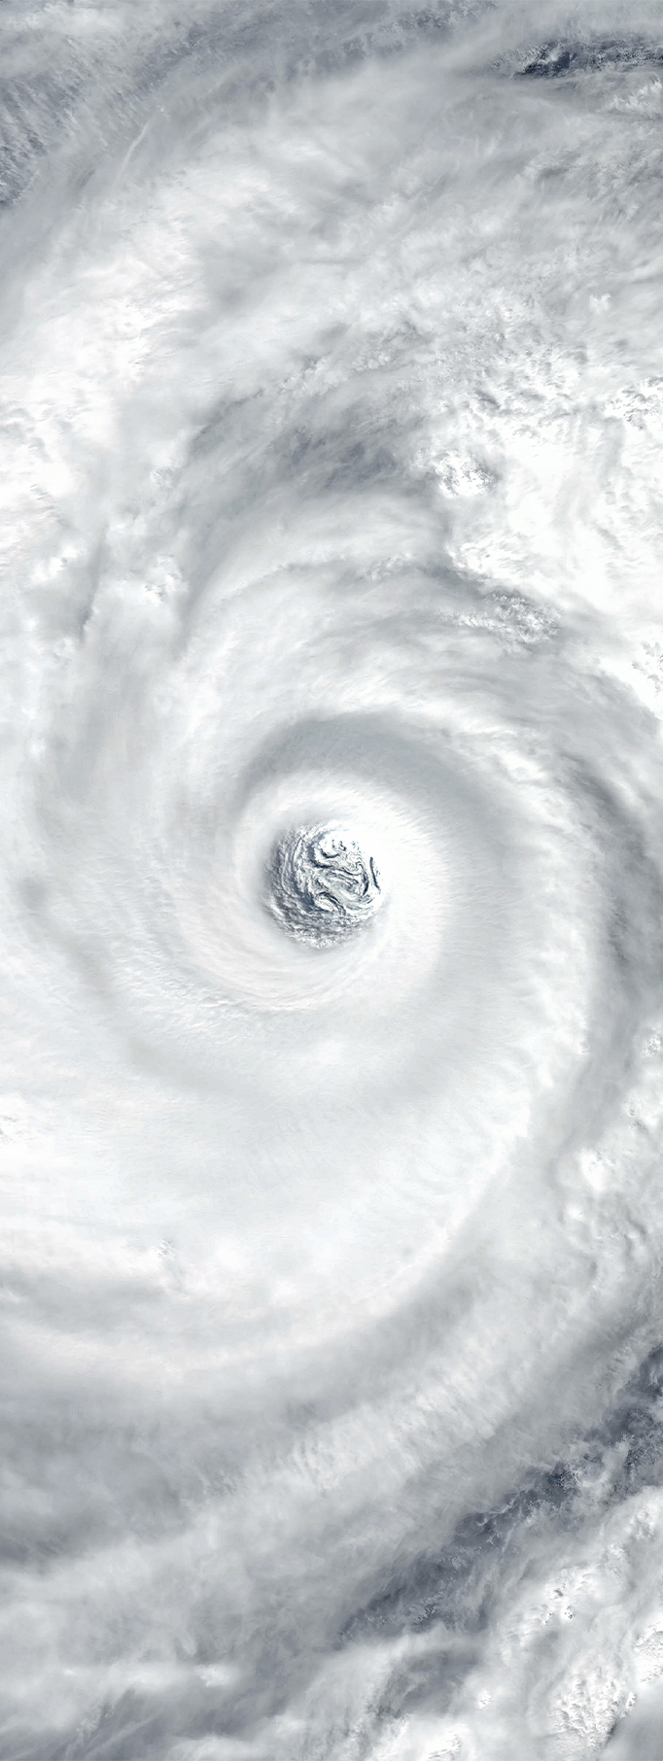

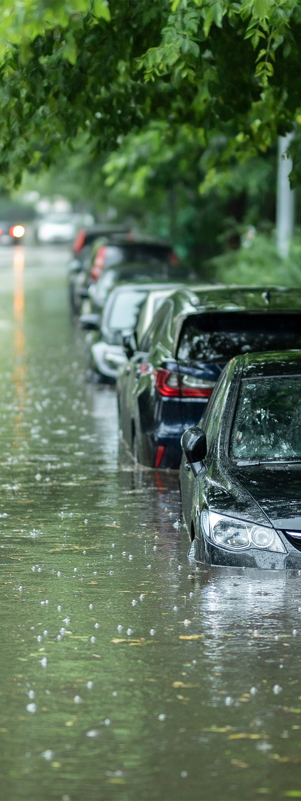
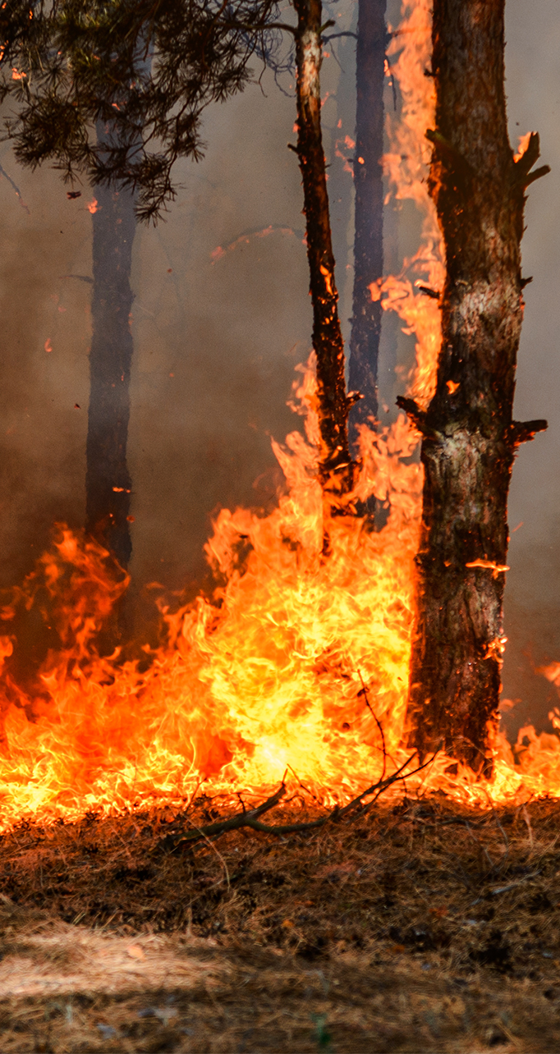
De effecten zijn al zichtbaar​
Notes:
Purpose : Severity + already now
Script
Earth’s ground temperature has already risen 1.1 degrees due to an increased greenhouse effect. 1.7 degrees in France – and we can already see the effects. Recently scientists revised their forecast for Europe in terms of warming scenario
Optional facilitation :
Here are some effects of the climate change. We can see them.
Wildfires in Australia, California, Sweden
Flood : river flooding, coastal flooding
Dryness
Typhoon : intensified storms and cyclones, increased frequency (hurricanes)
Transition
There is no way back for some of these changes.
But there is a way forward!

Slide 12
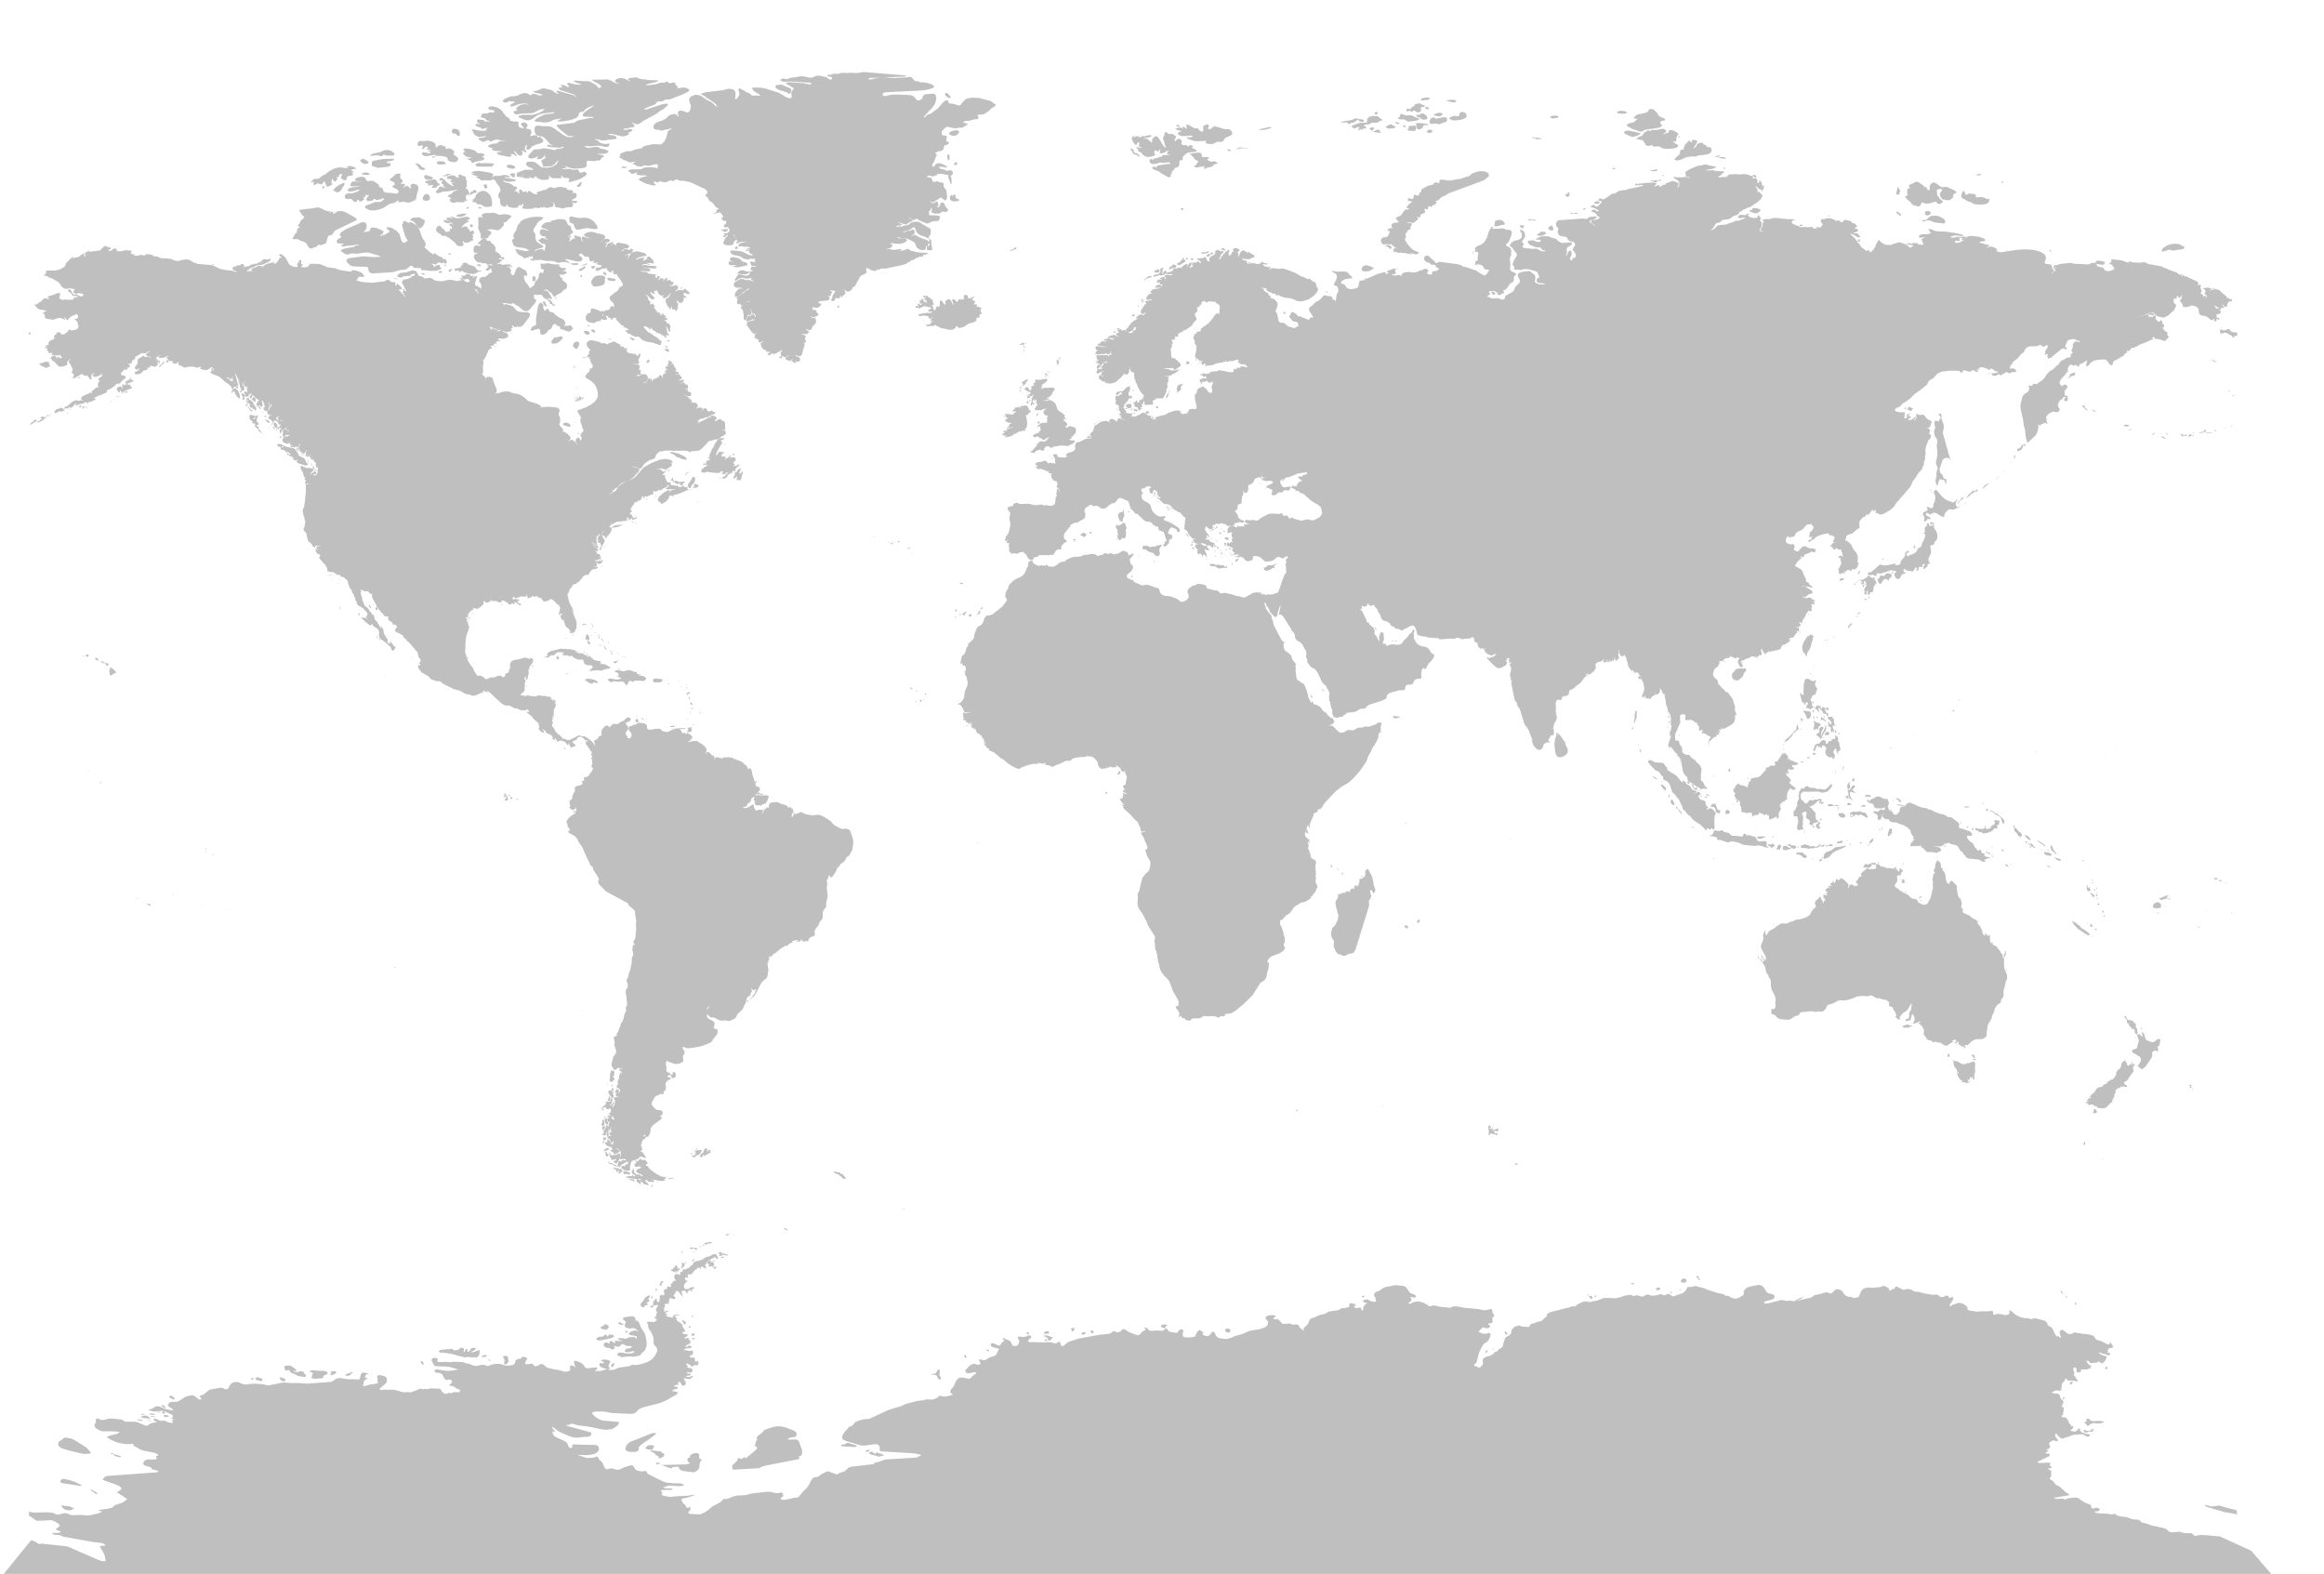
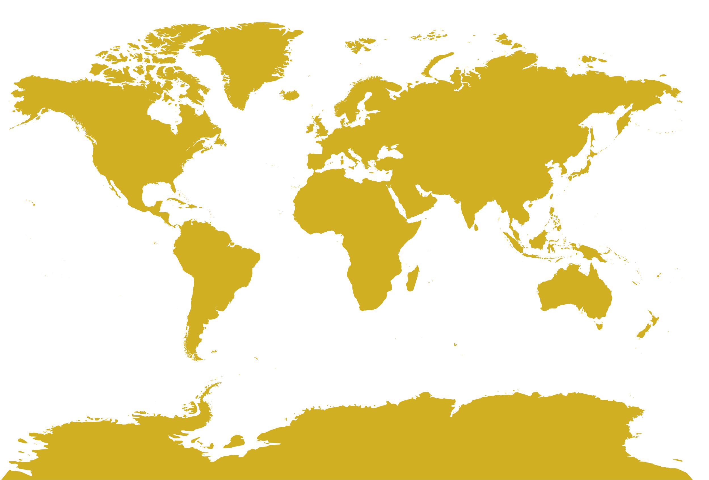


Het +4.0°C scenario een slecht vooruitzicht
Onbewoonbaar land
Source: Guardian graphic
Notes:
Purpose: At +4° the global map is very different
Script:
At +4° large areas of the planet would be inhabitable. And Ocean level rising would change the map of the world.
Deserts will expand into Europe; Asian rivers will dry out and sea life will rapidly decline.
Rising temperatures effect everything, where we can live, what we can eat, if we have water to drink. Which animals may live.
According to the UN, we will be 11 billion people by 2100. Compare that to the 1.5 billion people we were in 1850, and the 8 billion people we are today (2020).
Our modern lifestyle has caused temperatures to rise, but we can also be part of the solution. If we know what we have done, we can correct it.
Transition : Where do emissions come from?​.

Slide 13

DEEL 2
Onze
Commitments
Notes:
Purpose: Feel the company is responsible and acting
Script:
Let’s start with what Renault and the Volvo Group has committed to.
Being a responsible company, we have committed to the Paris Agreement. The Paris Agreement is a global framework on how to avoid dangerous climate change. This is done by limiting the global warming to well below 2 degrees.
Together with a growing number of companies, Renault and the Volvo Group have committed to this agreement by joining the Science Based Target initiative.
Transition: What are emissions due to transports?

Slide 14





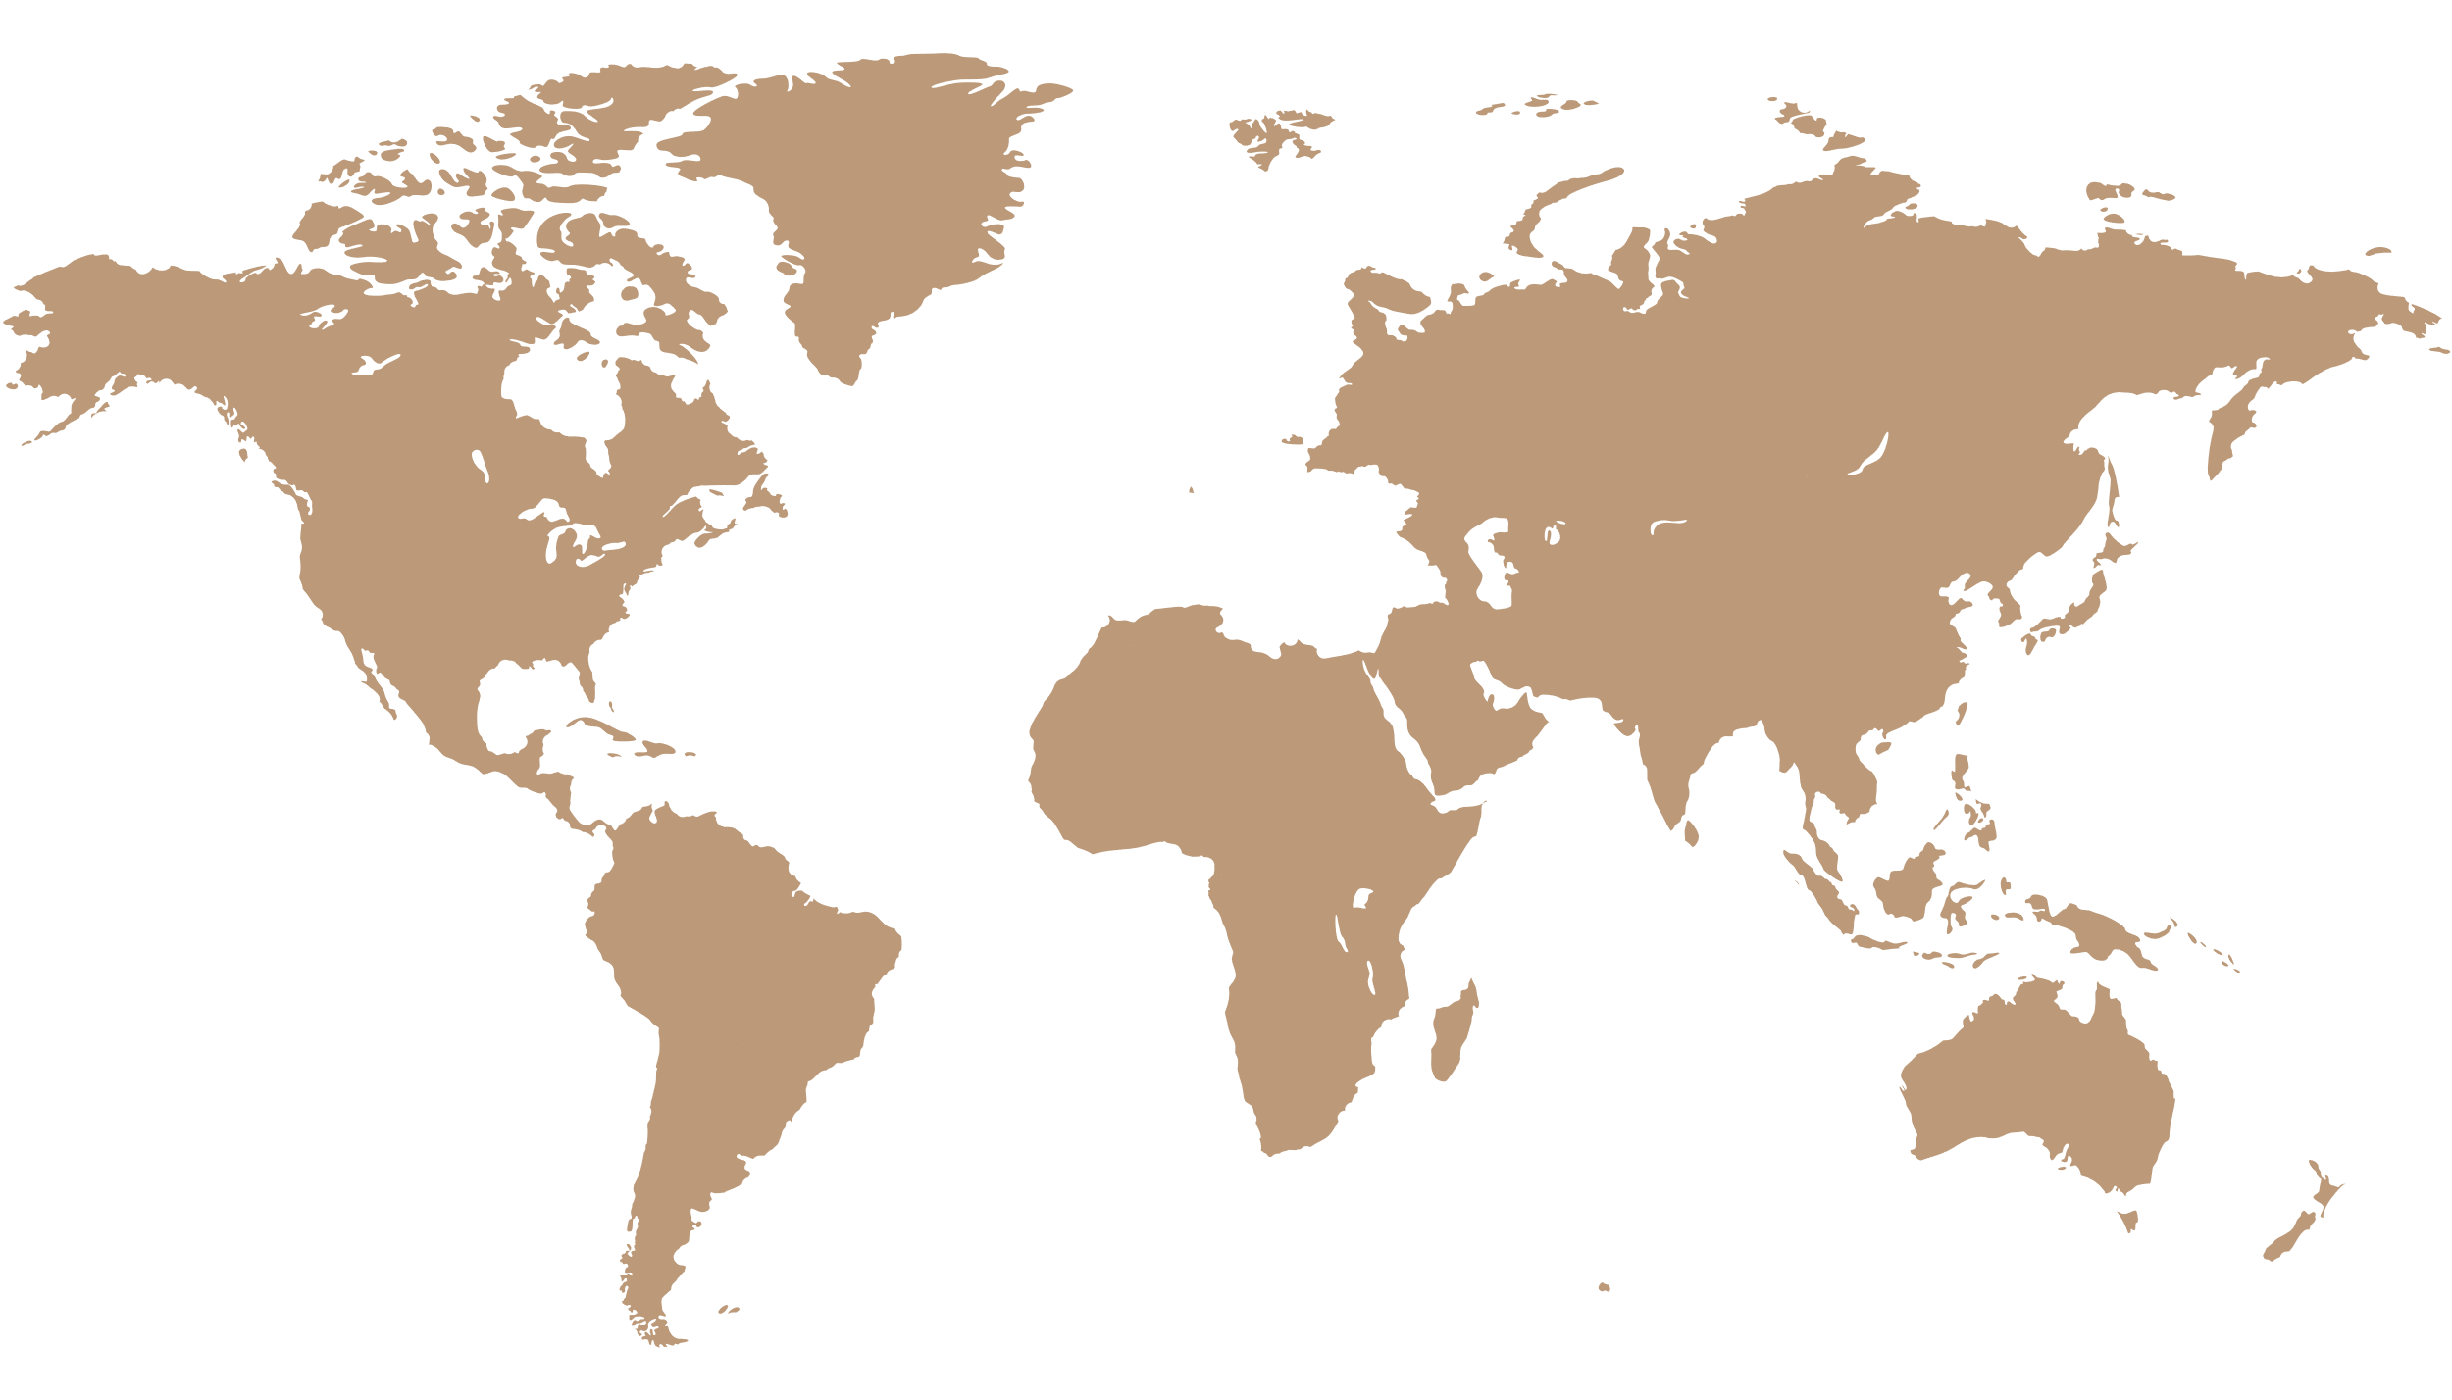

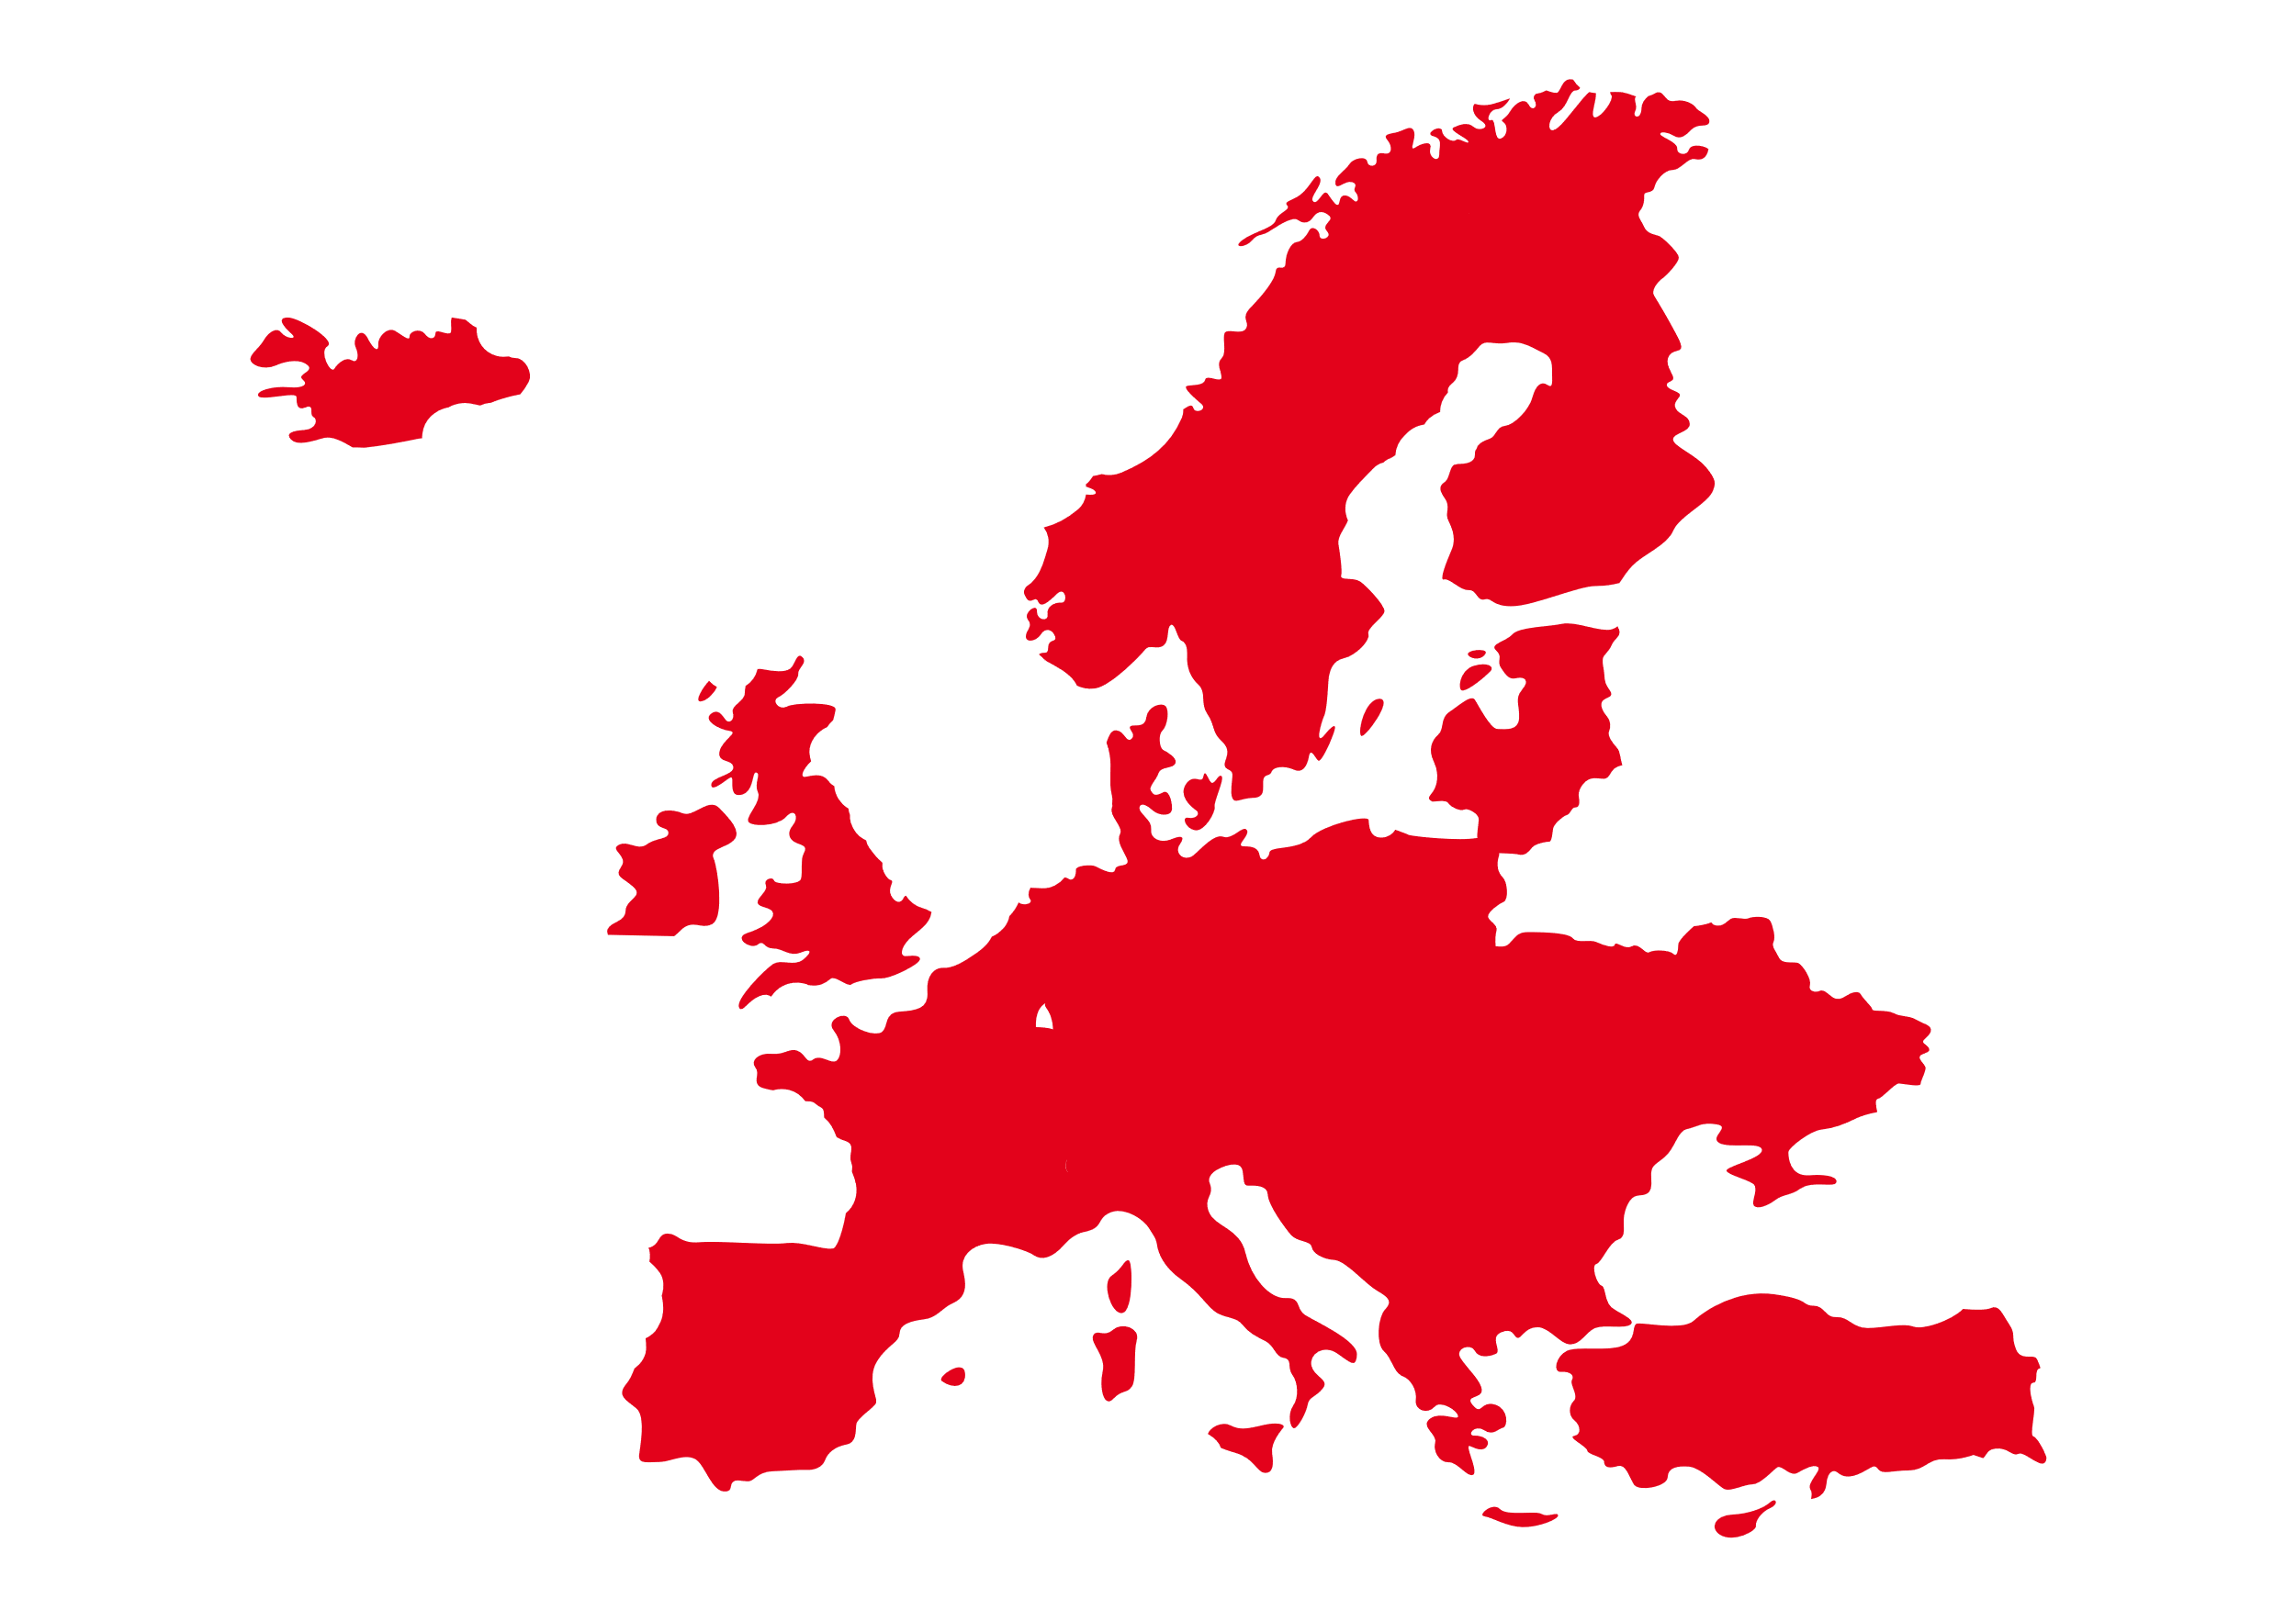
Uitstoot en effect door transport
28% 14%
7% 4%
Transports
Heavy trucks >3.5T
Source: EEA, EU27 in 2019
Notes:
Purpose : proportions + where we can act
Script:
In Europe, transports are responsible for 28% of the total CO2 emissions. 7% comes from heavy trucks. Around the world, trucks are responsible for 4% of the emissions.
This is where we can make a difference.
The main alternatives we have to decarbonize road freight are electrification, fuel cells or using biofuel.
Facilitation: Make sure participants understand the words: electrification, fuel cells, biofuel.

Slide 15

Wat betekend
Co2 neutraal?
CO₂

Slide 16
The good move
Klimaat
Bronnen
Mensen
Klimaat
50%
Elektrische trucks
100%
Fossielvrij aanbod
100%
Fossielvrij
wagenpark
Waterstof aanbod
-40% Co₂ emissies
2030
2040
2050
Notes:
Script:
This also aligns with Renault Trucks sustainability objectives for Climate, Resources and People.​
​
To save our climate, we strive towards fossil-free transport solutions. ​
​
To wrap-up:​
​
​We want our offer to be 100% fossil free in 2040. ​​
In 2030, CO2 emissions from all the trucks we sell must be reduced by 40% and half the trucks should be electric.​
In addition, we should have a hydrogen powered offer available in the second half of this decade.​
These are tough goals, so next we need to talk about our strategy to meet them. How can we achieve this?​
​
------------------------------
Facilitation : Explain
If we talk about the Paris agreements again, as a responsible company we must be CarbonNeutral in 2050
Here we read in 2040 . Why ? Because our trucks run for 10 years,
In 2050: it will be "100% fossil free offer” ROLLING TRUCKS
Example : I count the trucks I sell. A diesel truck sold in 2039, is no longer there in 2050 (by convention).
So fossil free objective in 2040 – included scope 1 and 2.
How to achieve this in 2040 ? We must sell half of our trucks in electric by 2030.
This is not obvious because it is a huge transition.
Yes, but for all the reasons explained, we are committed to the climate, we have no other choice.
➔ In the end, in 2050.. 100% FOSSIL FREE ROLLING TRUCKS

Slide 17
Ieder zal zijn verantwoordelijk-heid moeten nemen..
Notes:
Script:
We want to act as a responsible company !​
This is why we are engaged in this transition. ​
And why we are committed to these goals.​
--------------
English
Summary : we have covered -the climate urgency, -what commitments of the Group and why.
This affects our activities + our sales, over their whole product life
Transition
Now: What is our transportation solution strategy?

Slide 18
DEEL 3
Onze strategie
& transport
oplossingen
Notes:
Purpose : Introduction: what commitments
Script:
Let’s start with what Renault and the Volvo Group has committed to.
Being a responsible company, we have committed to the Paris Agreement. The Paris Agreement is a global framework on how to avoid dangerous climate change. This is done by limiting the global warming to well below 2 degrees.
Together with a growing number of companies, Renault and the Volvo Group have committed to this agreement by joining the Science Based Target initiative.

Slide 19



Titel
Brandstofverbruik
Circulariteit
Elektromobiliteit
Notes:
Purpose : Three main pilars of our strategy
Script:
Our strategy to reduce CO2 emissions rests on three pillars: fuel efficiency, circularity and electromobility.
Click
We need to offer trucks with ever-improving fuel efficiency.
Click
We need to extend the life of existing vehicles using a circular approach
Click
We need to provide 100% electric transport solutions. Electromobility is key to achieve emission-free transports, you will see why later.
These three things are all done in parallel!
Transition : Let’s start with fuel efficiency

Slide 20
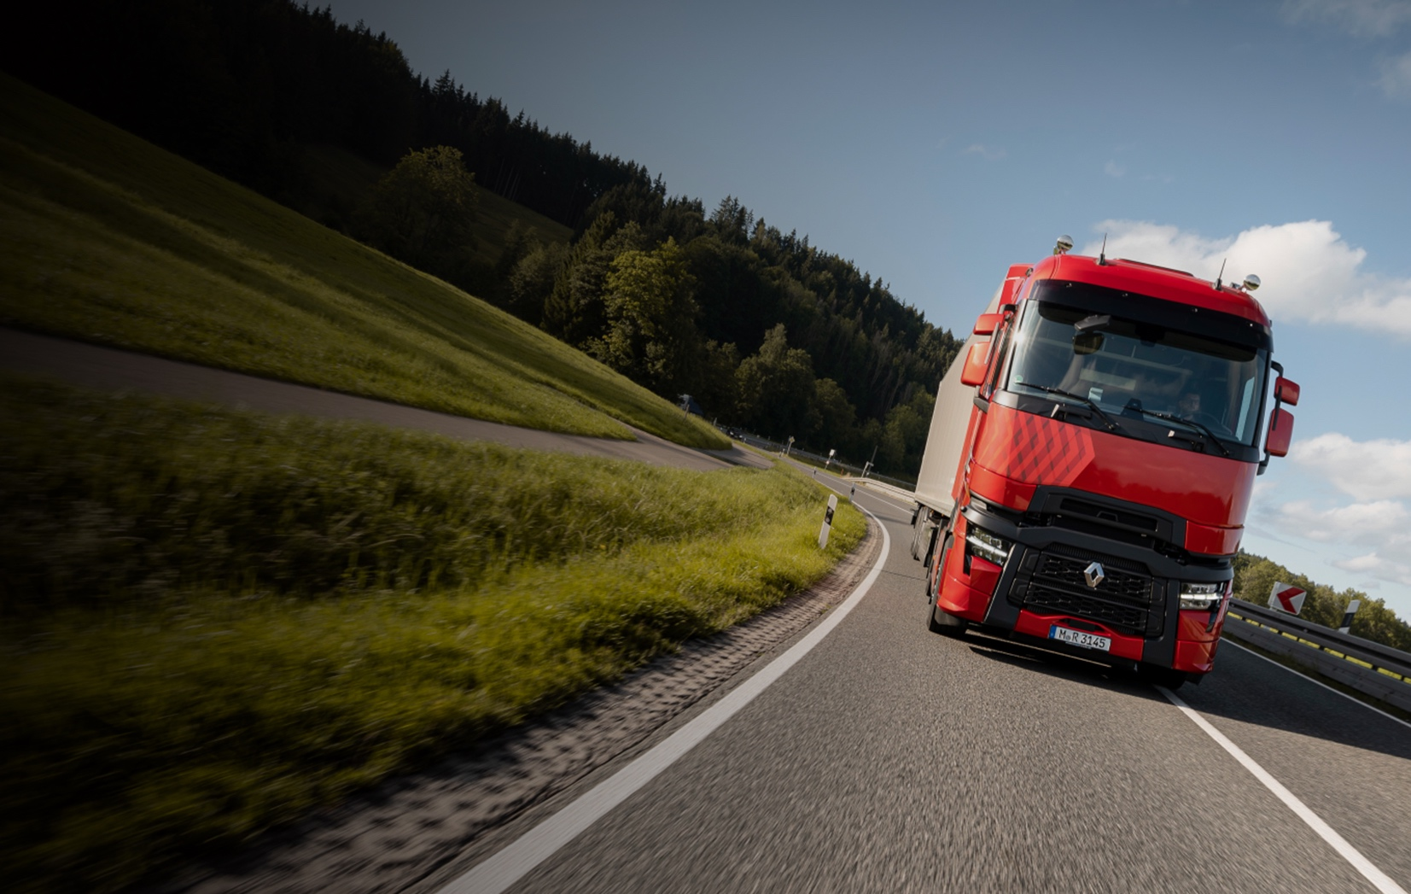

Verminderen van brandstofverbruik
-10%
Brandstof verbruik
Brandstof-verbruik
Nieuwe motoren
Turbo compound
Notes:
Purpose : Present example of fuel efficiency
Script:
Because we can’t go all electric at once, we need to improve the fuel efficiency of our diesel engines. And we are doing that already! Our new Renault TCK Evolution trucks offer up to ten percent less fuel consumption, mainly due to engine improvement (new piston, turbo compound).
-------------
Comments
Consumption is a very broad subject We can discuss it in another session.
Current engines consume about 10% less than in 2021 : In 2022 we have accumulated several improvements: new piston (DE engine) and Turbo compound option
There are still big investments in diesel engines (Euro 7 standards) and on consumption optimization tools (Optifleet)
Even if it's only for a few years to come, This remains an important focus
20% electric by 2025 - /80% diesel
Important: usage, driver training, potential for a lot of gains. Can bring 10% savings.
Specifics of the truck : the right tires, deflectors, axle torque, etc....

Slide 21

Ons gebruik van hulpbronnen verminderen
Regenereren
Circulariteit
Recycleren
Hergebruiken
Notes:
Purpose : How to reduce our use of resources
Circularity is about reducing our use of natural resources (and so the CO2 emissions related to production of materials). We must limit the impact on the environment by taking into account the second and third life of our vehicles. How are they being reused?
Thinking of the economy as circular allows us to even further reduce our CO2 footprint!
Circularity is a big topic, but not the focus for today.
Additional information if someone asks, or if you want to go somewhat deeper---
Regeneration means that we renovate and recondition used vehicles. We update their software and adopt the latest technology available to extend their working lives. Anything to keep them on the road longer, using improvements that have been made since their release.
We repurpose vehicles in our Used Truck Factory, transforming them into customized second-hand vehicles. A tractor can be transformed into a rigid truck and diesel engines can be converted to use biofuel.
To recycle, we offer renovated components for standard replacements, so they can have 60% less of an environmental impact than that of new parts.
------------------------------------------------------------
Facilitation : with examples
Examples: quarry truck = > less severe use, roads or other country.
We offer RECYCLING channels – buy-backs (RT takes over the vehicles after a few years)
REPURPOSE: logging trucks: 2nd life in the port, between boat and logistics buildings
Batteries: after 7 years a battery is not dead, it has lost 20% of its capacity – it can still be used for energy storage at night, solar.
When really at the end of life, then recycling : proportion reclyclable = 50% today but constantly increasing and, with increasingly harsh regulatory constraints

Slide 22

We moeten naar elektrisch vervoer
50% Elektrische trucks
100%
Fossielvrij wagenpark
2030
2050
Notes:
Script:
Now on to the main pillar for our future: electromobility.
To reach the 1.5-degree target, we have to go electric.
Click
Renault Trucks aims to sell 50% electric trucks in 2030
Click
and have a 100% fossil free fleet rolling in 2050.
Transition
But why Renault Trucks chose electromobility as the best solution for decarbonization ?

Slide 23


Well to wheel CO2 emissies
826g
Diesel
CO₂ per kilometer
VK (342g)
Spanje (350g)
Gedeeld door 10
Frankrijk
Nederland (422g)
Duitsland (566g)
80g
Elektriciteit
Zwitserland (175g)
EU28 Gemiddelde (402g)
Polen (934g)
Source: JEC 2020 report for diesel and gas, IEA for electricity
Data from 2016
Notes:
Purpose : Compare emissions : Diesel versus Electricity
Script :
When we compare the emissions from diesel fuel and electricity from the grid, electricity wins out. Especially when you consider that electricity will only become greener and greener.
Click
When you calculate the emissions from diesel fuel, for a 16 ton vehicle, taking everything into account from well to wheel, it results in 826g CO2 per kilometer.
Click
Electricity, however, can be produced with as little as 80g CO2 per kilometer! That’s the figure for France, where we have a lot of nuclear power.
Click
As you can see, the emissions from producing electricity varies a lot from country to country, but these numbers will only improve with a better electricity mix.
The numbers in this example are from 2016, and as you can see Poland stands out, producing their electricity from coal.
On average though, electricity emits far less than the other alternatives, and it has only improved since.
Facilitation : More comments
Electricity also consumes CO2. The level depends on the mode of production of electricity.
An electric truck driving in Poland, pollutes more than in Switzerland.
Well to wheel means = From well to wheel : how much it emits per kilometer
There are other types of comparisons, that lead to the same conclusions. (du berceau à la tombe, which therefore includes the manufacture and destruction of the vehicle)
Possibly give the link --- https://app.electricitymaps.com/map
@ElectricityMaps | Live 24/7 CO2 emissions of electricity consumption
Electricity Maps is a live 24/7 visualization of where your electricity comes from and how much CO2 was emitted to produce it.
Conclusion : The electric vehicle is relevant today in the majority of countries, and will be even more so when electricity is more carbon-free (solar, wind, hydraulic, ...)

Slide 24
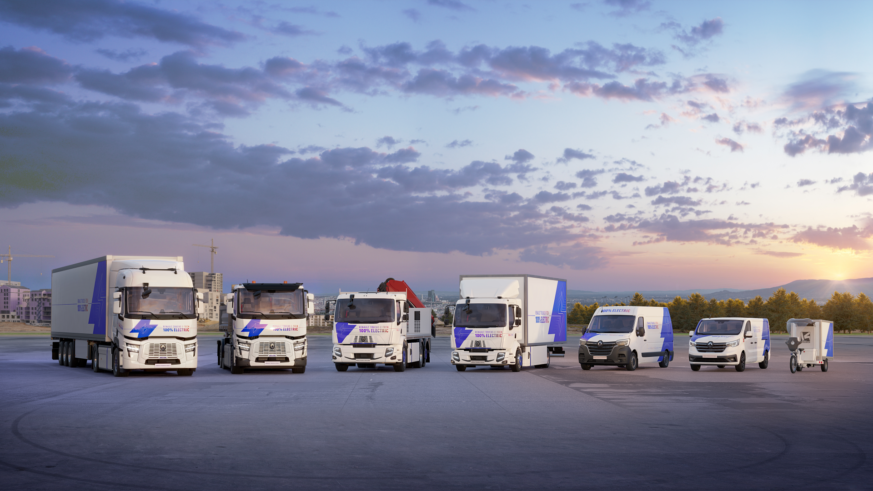
Onze trucks
Notes:
So, given that electric trucks are clearly in our future, what can we offer today?
Renault already has three electric trucks in the E-TECH range.
They range from 3.1 to 26 tons and meet urban requirements from delivery and distribution of goods to waste collection.
------------------
More comments:
We can also mention the Kluster (cargo bike sold by Renault Trucks and produced in Venissieux)

Slide 25
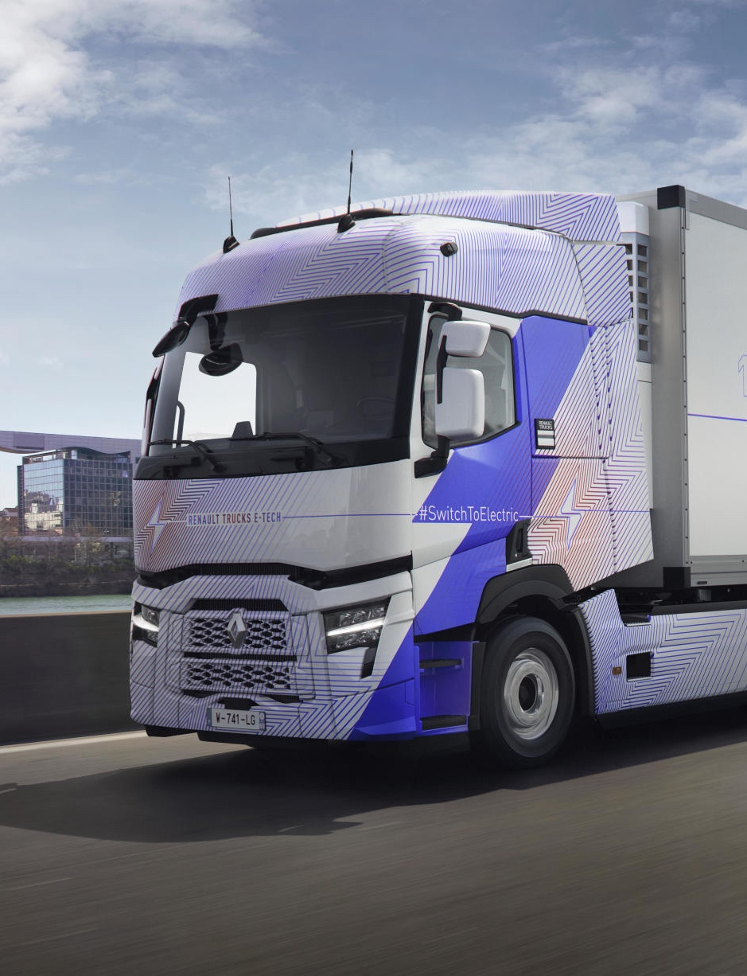
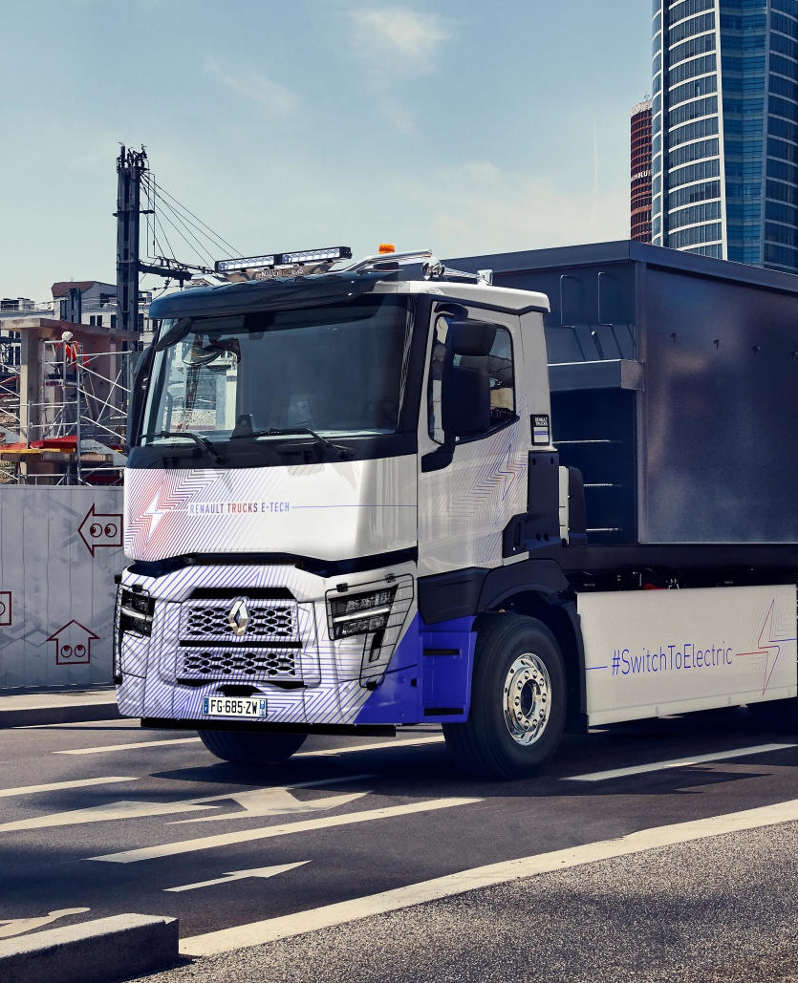
Renault Trucks
E-TECH
T
Renault Trucks
E-TECH
C
Electro-mobility
Notes:
In 2023 we will expand this line with the Renault Trucks E-TECH T and C Electric heavy-duty trucks, which are designed for regional distribution and construction work.
Remember how we plan to roll out electric vehicles segment by segment? These are next in line.

Slide 26
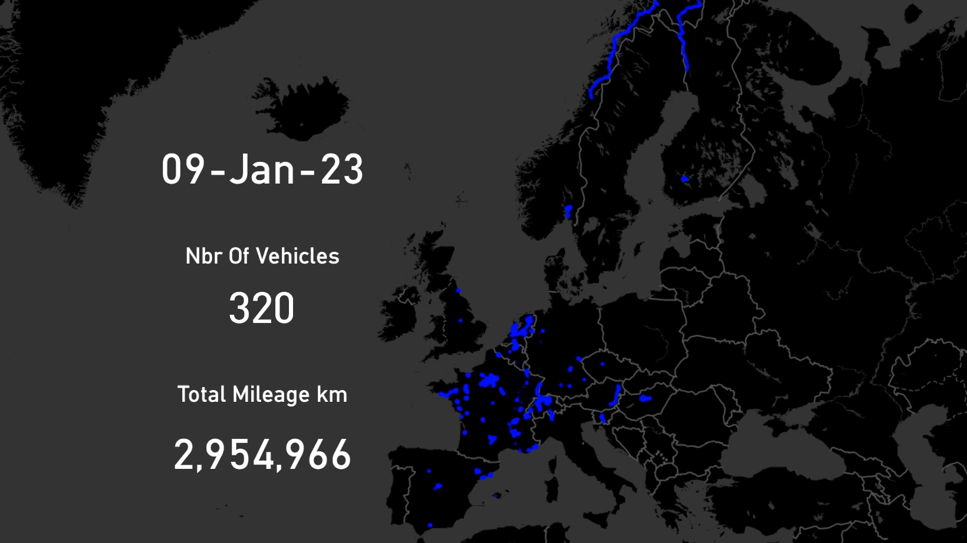
9 miljoen
Kilometers
Europees
Notes:
Message :
Nous avons une flotte de camions E-TECH en opération depuis bientôt 2 ans (800 camions et 9M km)
Cette expérience nous a permis d’apprendre quelles sont les principales difficultés rencontrées par nos clients
C’est pour cela que nous avons développés des solutions pour accompagner nos clients dans cette transition
2 piliers:
Notre réseau pour la proximité
Nos nouveaux services qui reposent sur l’exploitation des données connectées de nos véhicules

Slide 27
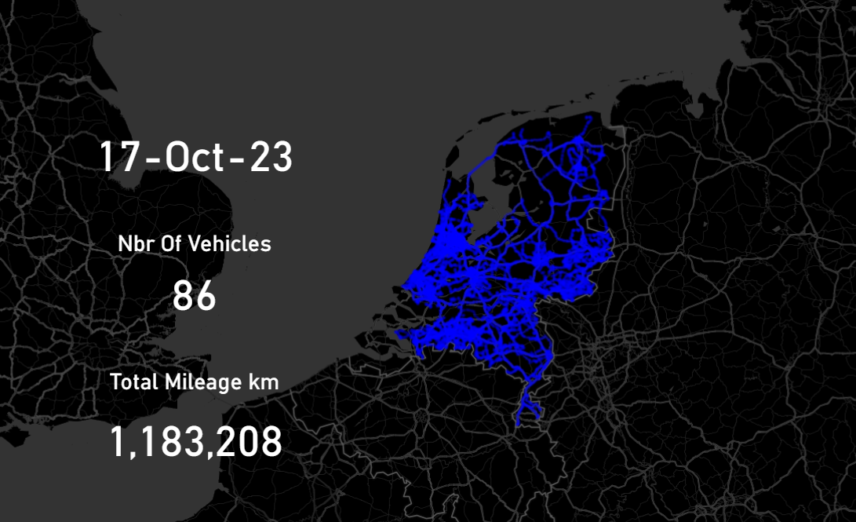
Electro-mobility
1,2 milj.
Kilometers in Nederland!
Notes:
These models are on the road already and have so far ranked up more than 2 million kilometers for our customers!

Slide 28
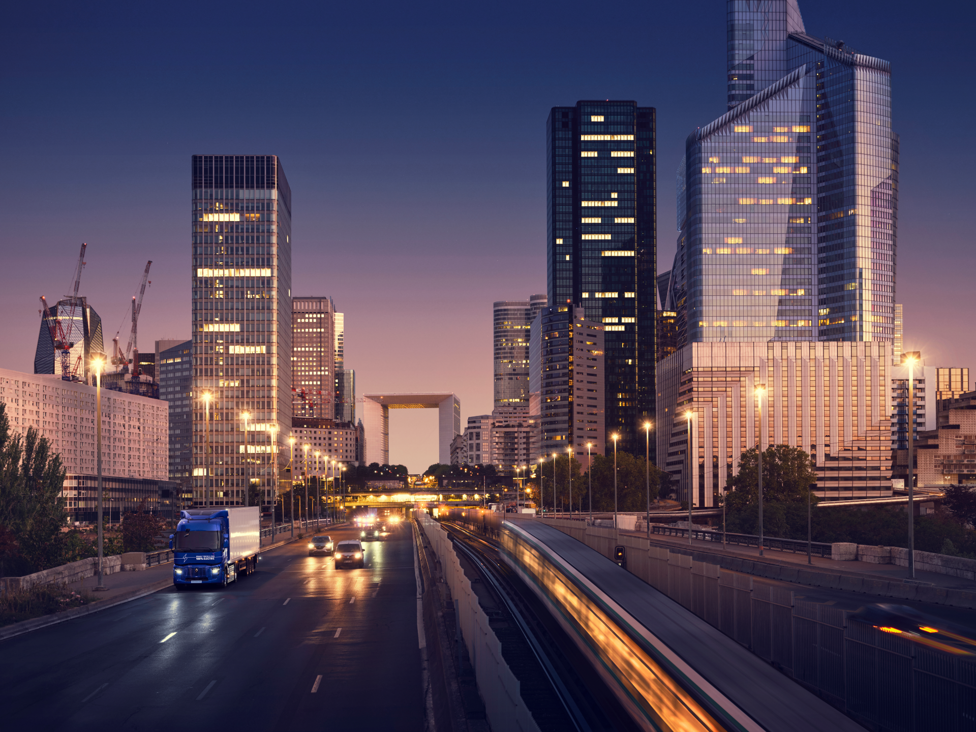
De toekomst van transport
Energy services
Oplaadinfrastructuur, energie optimalisatie, …
Demanding long-haul
Brandstofcel elektrische vrachtwagen
Regional-haul
Batterij elektrisch voertuig
Heavy construction
Batterij elektrisch voertuig
Urban construction
Batterij elektrisch voertuig
Waste & recycling / environment
Batterij elektrisch voertuig
Urban distribution
Batterij elektrisch voertuig
2019
2022
2025
2030
Notes:
Click
We already produce medium duty electric trucks for urban distribution and waste and recycling.
Click
Next will be electric trucks for urban construction, heavy construction and regional distribution.
Click
And finally in the future even long-haul, using batteries or hydrogen fuel cells.
Click
In addition to all this, we are also developing a complete set of related services including battery solutions, charging infrastructure, energy optimization and more.
-----------------------------
Facilitation :
Some segments will not be covered in 2025
Expensive
Will take time

Slide 29
Toekomstbeeld Co2 neutraal transport
100%
Aandeel nieuwe vrachtwagens
Elektrisch  Accu (BEV)
CO2 neutral elektriciteit
Wagenpark
FC aandeel?
Verbrandingsmotor
(ICE)
Elektrisch  Brandstofcel (FCEV)
Carbon neutral hydrogen
ICE aandeel?
Bio brandstoffen, waterstof
0%
2020
2030
2040
2050
Koolstof houdende brandstof
Koolstof neutraal
Notes:
Purpose : Present trends regarding technologies
Script:
Our goal is to only sell carbon neutral vehicles by 2040, so that the rolling fleet in 2050 will also be carbon neutral.
Note that this doesn’t mean that all our trucks will be electric.
We expect some trucks to be powered by hydrogen (with fuel cells) and internal combustion engines running on biofuels or hydrogen, most likely in heavy-duty applications. But together; battery electric and fuel cell electric are the solutions that will allow us to be carbon neutral by 2050.
How big the share fuel cell technology and ICE running on biofuel (or hydrogen) will have we simply don’t know yet. These technologies are still being developed.
But we do know one thing: electric trucks are by far the best option we have to decarbonize our transport solutions!
---------------
Conclusion:
Nothing is decided,
It's a vision of the Volvo Group – That's why we see arrows (show fluctuations)
What proportions? Depends on technologies and their prices.

Slide 30






Samen werken aan de toekomst
Co₂ doelstelling
Technologische opties
Zakelijk ecosysteem
Wij begrijpen wat u nodig heeft
Slim opladen
Uw partner voor decarbonization
Route
planer
Fleet &
routes analyse
Wij ondersteunen bij de implementatie en operatie
Wij analyseren uw activiteiten
Training
& coaching
Site analysis
Site analyse
Fleet monitoring
Upgrade
& life
extension
Wij ontwerpen uw oplossing
Service contracten
Financiering
& subsidies
Demo inzet
Volledig voertuig
Opladen
Notes:
Purpose: : Present the wheel of decarbonisation - The use of electric vehicles is a big change for our customers. We provide knowledge and tools to advise them.
Script :
We want close partnerships, so we can find the right electric mobility solution for each customer, need and usage. Think of it as unique projects, where we include transporters, retail, manufacturers and public authorities to find the best solutions.
This is what we say to our customers:
Click
We understand your needs.
Click
We analyze your activity.
Click
We design your solution.
Click
We support your implementation and operations.
Renault is your partner for decarbonization!
Switching to electric is not just a technology shift. It’s about people and involving everyone in the shift.
Facilitation : Questions
How are you impacted?
What is your reaction?
What will be your next step?

Slide 31
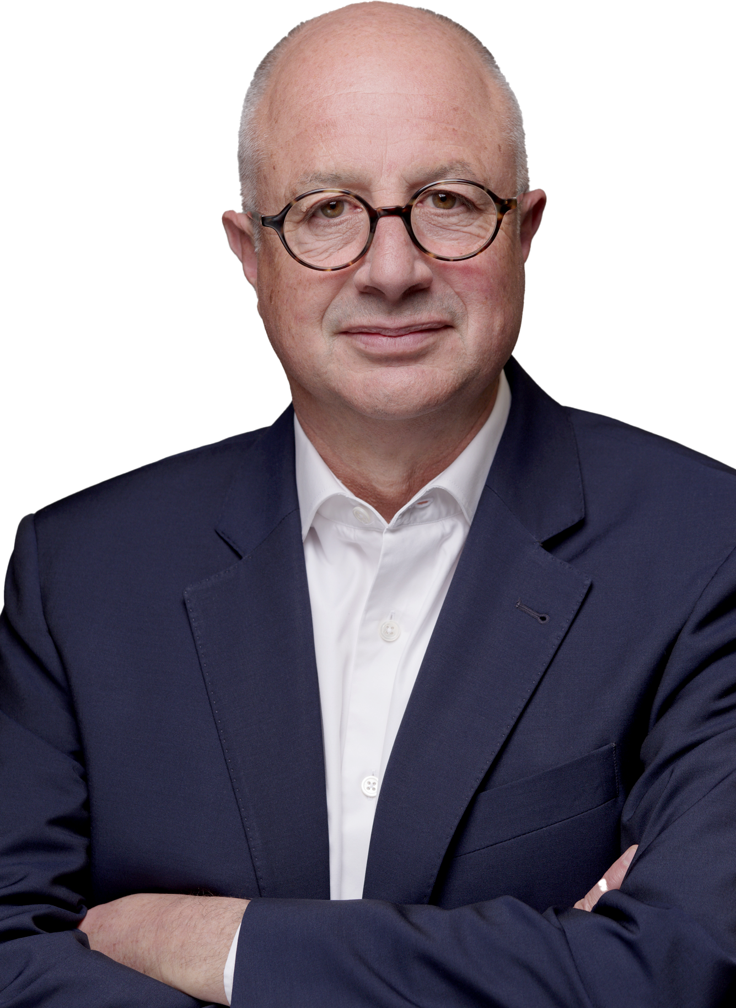
A change in culture.
For us and our customers.
– Bruno Blin
Notes:
This is a change in culture for us and our customers – We will not « just sell a truck », the study will be more complex.
As a summary
We want to act as a responsible company !​
This is why we are engaged in this transition. ​
And why we are committed to these goals.​

Slide 32
Join the good move
Notes:
Thank you
What feedback on the session?

